Slide 1
EOC & MFC:
MEASURING ATTENTIVENESS OF STUDENTS IN CLASS USING COMPUTER VISION
TEAM NUMBER 2
Niranjan - CB.SC.U4AIE24046
Prajit -CB.SC.U4AIE24062
Deeksha -CB.SC.U4AIE24015
Don Arun -CB.SC.U4AIE24016

Slide 2
Objective:
The objective of this project is to develop a CNN-based system that can accurately analyze images to measure attentiveness. The system will focus on detecting facial expressions and eye movements to classify whether a person is focused or distracted.
By using deep learning techniques, the model aims to provide real-time attentiveness tracking for applications in education, driver monitoring, and workplace productivity.
The main objective is to create a solution for attentiveness detection that improves learning experiences, and overall engagement.
Notes:
Yes, YOLO (You Only Look Once) is an implementation of Convolutional Neural Networks (CNNs), specifically designed for real-time object detection.
How YOLO Uses CNN
YOLO is based on a single CNN that performs both object detection and classification in one forward pass.

Slide 3
Dataset:
DriverGaze dataset contains pictures of drivers looking at various things, but we
are handpicking images that are useful for our application.
Use the ‘DriverGaze’ dataset and scan the eyes to decide whether the student is
sleeping
listening to the lecture
We are using eyes open for ‘attentive’ and eyes closed for ‘not attentive’

Slide 4
Methodology
Preprocessing Steps:
⚬Image to array conversion
⚬Image resizing (96x96 pixels)
⚬Label extraction and encoding
⚬Normalization (scaling pixel values between 0 and 1)
⚬Train-test split (80% training, 20% validation)
⚬One-hot encoding for labels (Binary classification: 0 or 1)
Notes:
Process data that had a grid pattern(image),
Automates special hierarchies of features from low to high,
Neural network: it is like a digital brain. learns from examples. spots patterns by itself
it is called 'neural' because the structure of the network is like that of the brain's neurons

Slide 5
Modelling:
⚬ Defining the model with input image of shape (96,96,3)
Convolutional Layers:
Conv2D with( 32 filters, kernel size (3, 3), Activation: ReLU)
MaxPooling2D: Pool size (3, 3) to reduce spatial dimensions.
2. Conv2D with (64 filters, kernel size (3, 3),Activation: ReLU)
MaxPooling2D: Pool size (2, 2).
3.Conv2D with (128 filters, kernel size (3, 3),Activation: ReLU)
MaxPooling2D: Pool size (2, 2).
Flatten Layer: After the final convolutional and pooling layers, the multi-dimensional feature maps are flattened into a one-dimensional feature.
Fully Connected(Dense) Layers:
Dense Layer with (1024 neurons, ReLU activation)
Dropout: Rate 0.5 for regularization.
Output layer: Dense (2 neurons, Softmax activation)
Notes:
Process data that had a grid pattern(image),
Automates special hierarchies of features from low to high,
Neural network: it is like a digital brain. learns from examples. spots patterns by itself
it is called 'neural' because the structure of the network is like that of the brain's neurons

Slide 6
Model Compilation:
Optimizer: Adam optimizer
Loss function: Binary Crossentropy
Metric: Accuracy(correct predictions)
Notes:
Process data that had a grid pattern(image),
Automates special hierarchies of features from low to high,
Neural network: it is like a digital brain. learns from examples. spots patterns by itself
it is called 'neural' because the structure of the network is like that of the brain's neurons

Slide 7
Model Traning and Evaluation
Training Configuration:
Epochs: 50
Batch Size: 32
Validation Split: 20%
Performance Metrics:
Accuracy Score
Loss Score
Model performance:
Training Accuracy:95%
Validation Accuracy:90%
Training Loss:0.1
Validation Loss:0.2
Notes:
Process data that had a grid pattern(image),
Automates special hierarchies of features from low to high,
Neural network: it is like a digital brain. learns from examples. spots patterns by itself
it is called 'neural' because the structure of the network is like that of the brain's neurons

Slide 8
Model Deployment and Prediction:
•Trained Model is Saved in Keras Format ( .keras file)
Prediction Pipeline:
⚬Save and Load the trained model
⚬Preprocess the input image(resize/normalization) before the prediction
⚬Predict and map class indices back to the label
⚬Run it live in webcam or in app.
Notes:
Process data that had a grid pattern(image),
Automates special hierarchies of features from low to high,
Neural network: it is like a digital brain. learns from examples. spots patterns by itself
it is called 'neural' because the structure of the network is like that of the brain's neurons

Slide 9
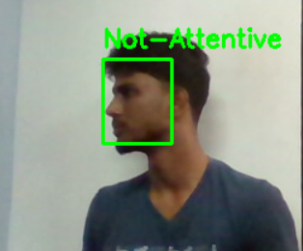
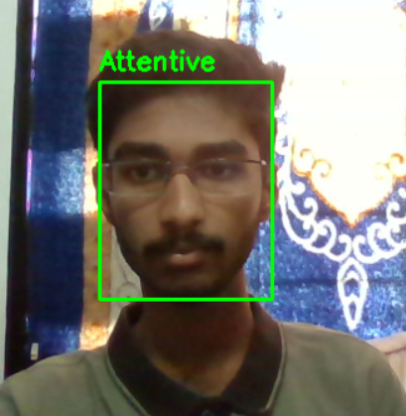
Result Analysis:
Notes:
Process data that had a grid pattern(image),
Automates special hierarchies of features from low to high,
Neural network: it is like a digital brain. learns from examples. spots patterns by itself
it is called 'neural' because the structure of the network is like that of the brain's neurons

Slide 10
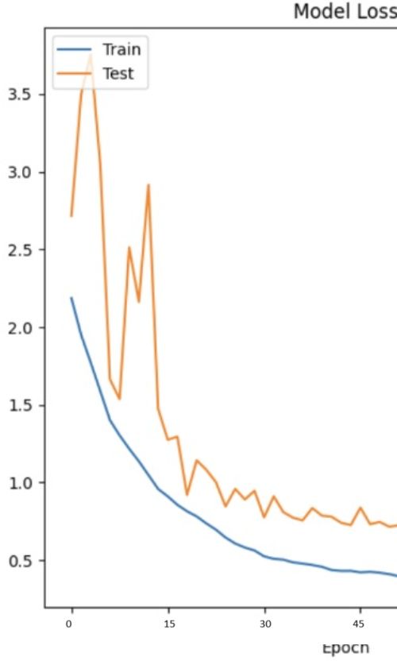
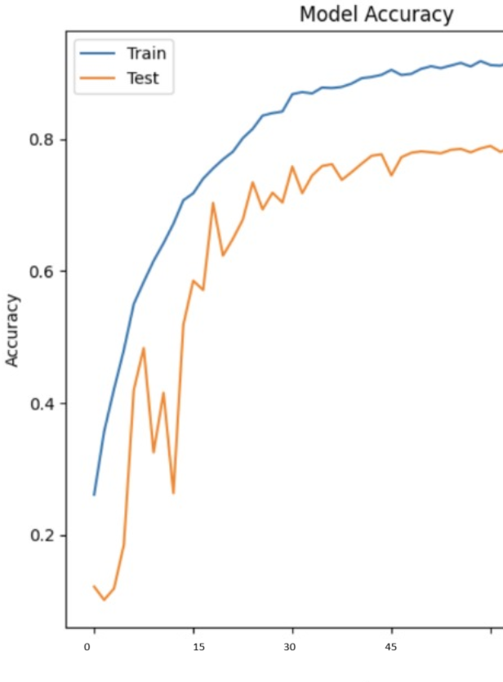
Result Analysis:
Notes:
Process data that had a grid pattern(image),
Automates special hierarchies of features from low to high,
Neural network: it is like a digital brain. learns from examples. spots patterns by itself
it is called 'neural' because the structure of the network is like that of the brain's neurons

Slide 11
Thank You

